Slide 1
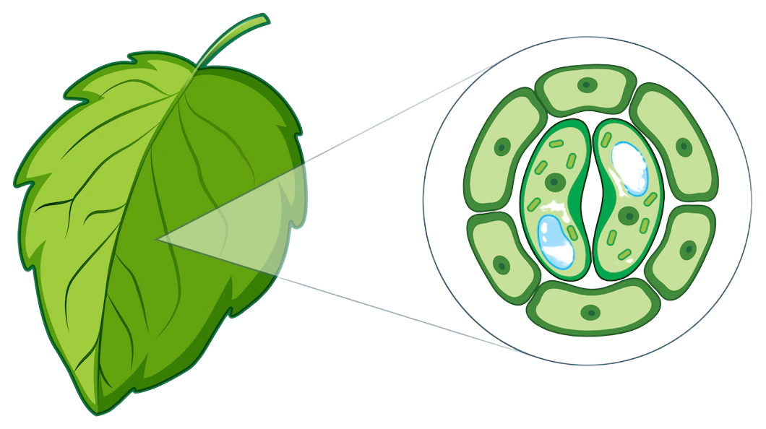
Plant Disease Detection and Classification using CNN
Presented by
Internal Guide
Mr. M. Prashanth
ARUN – C0
SATWIKA- A6
GNANESHWAR- B1
DEVISREE- 88

Slide 2
Introduction

Slide 3
Crop Diseases
The majority of important crops have several diseases throughout their crop cycle.
For farmers, identifying these diseases and altering the crops is absolutely crucial.
Most crops need specific care and insecticides to address problems.

Slide 4
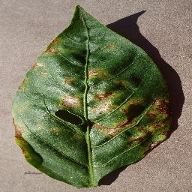
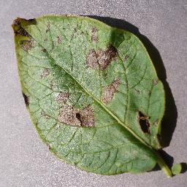
Some Common Crops
Pepper Bacterial spot
Potato Early Blight Disease

Slide 5

Problem
Recognizing various diseases and infestations on certain crops is typically a persistent issue for farmers.
This results in several crop failures.

Slide 6
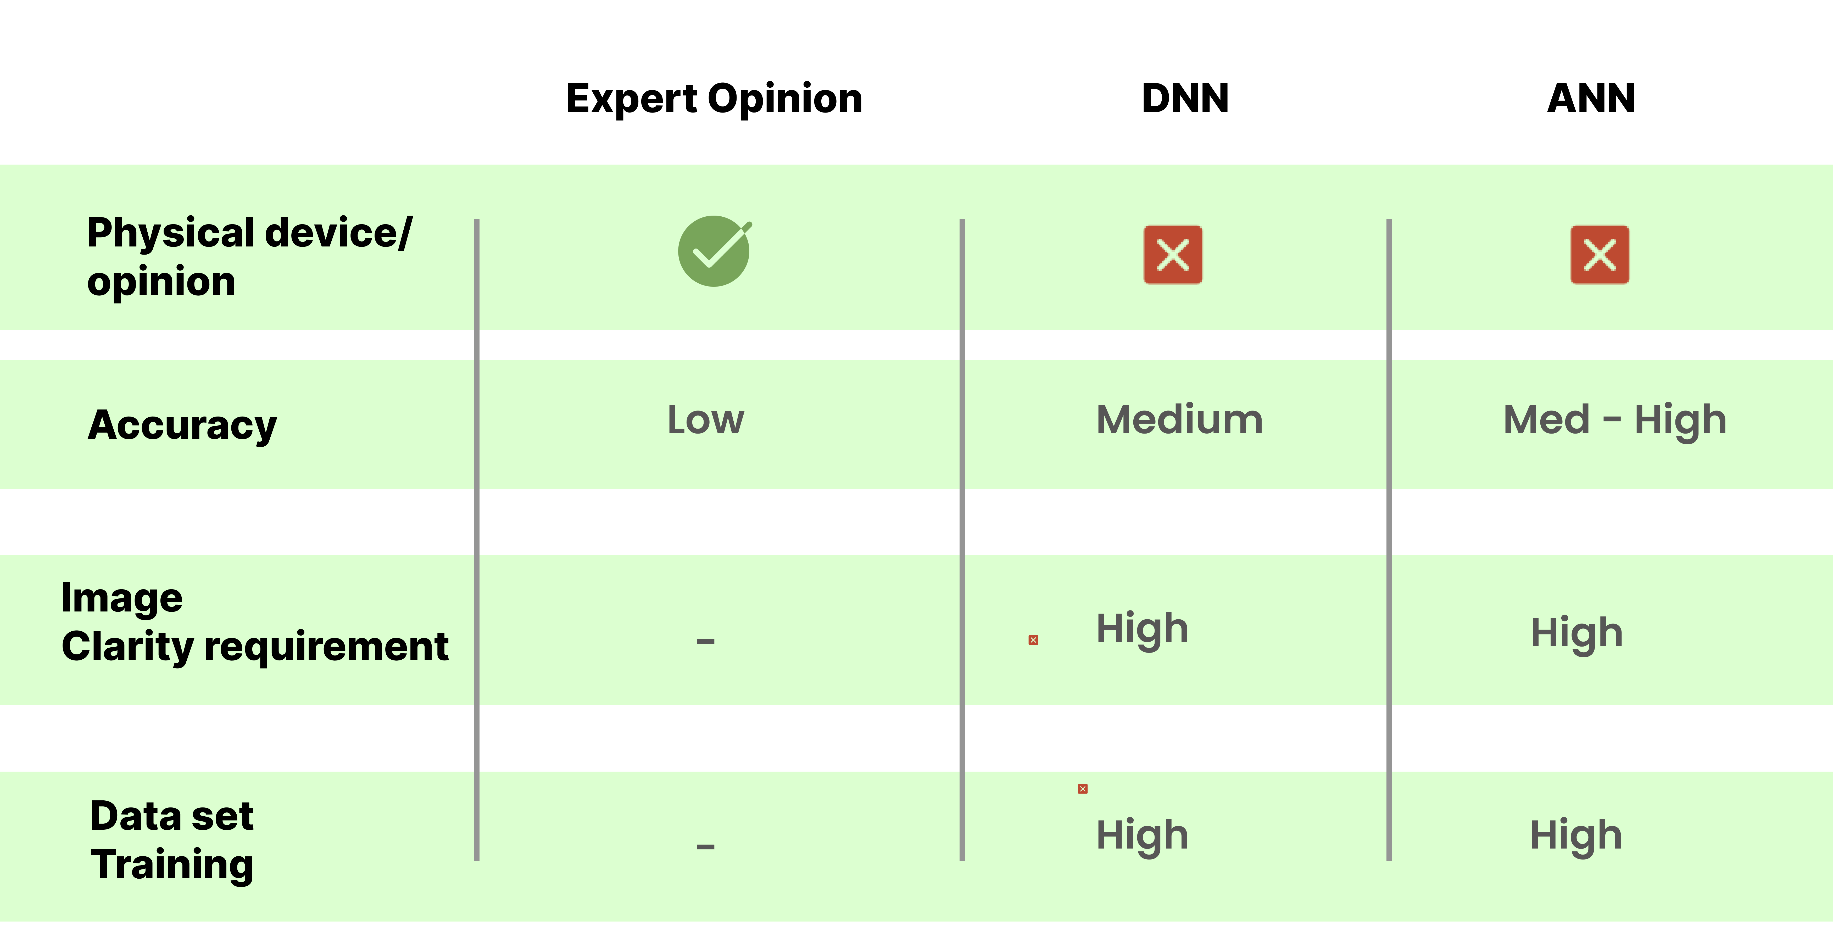
Existing Solutions

Slide 7
Existing Solutions
DRAWBACKS:
Data acquisition
Requires good GPU to train
Accuracy decreases when image quality drops
Trained on single image only

Slide 8
Proposed Solution
Data Set
Obtaining the plant picture dataset, which consists of 14 distinct plant species and 38 different plant disease classes.
Processing
Pre-processing of the image in different convolutional layers.
Classification
Classification of plant illnesses indicating the health or disease of the provided plant leaf image.

Slide 9
Proposed Solution
ADVANTAGES
Can have an excellent recognition
Uses CNN for faster and more accuracy
Can be trained further for more plants and crops
Remedy prediction can be layered on top

Slide 10
Architecture

Slide 11
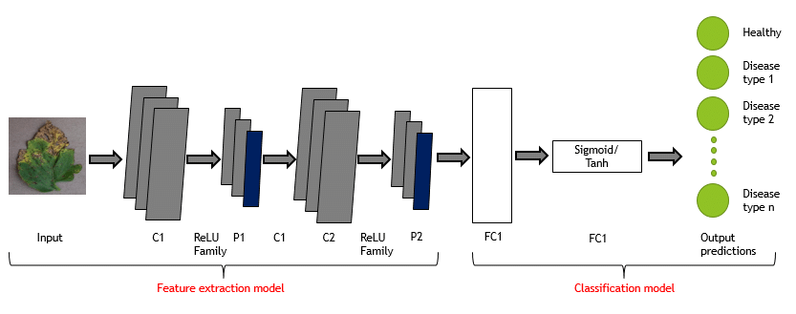
System Architecture

Slide 12
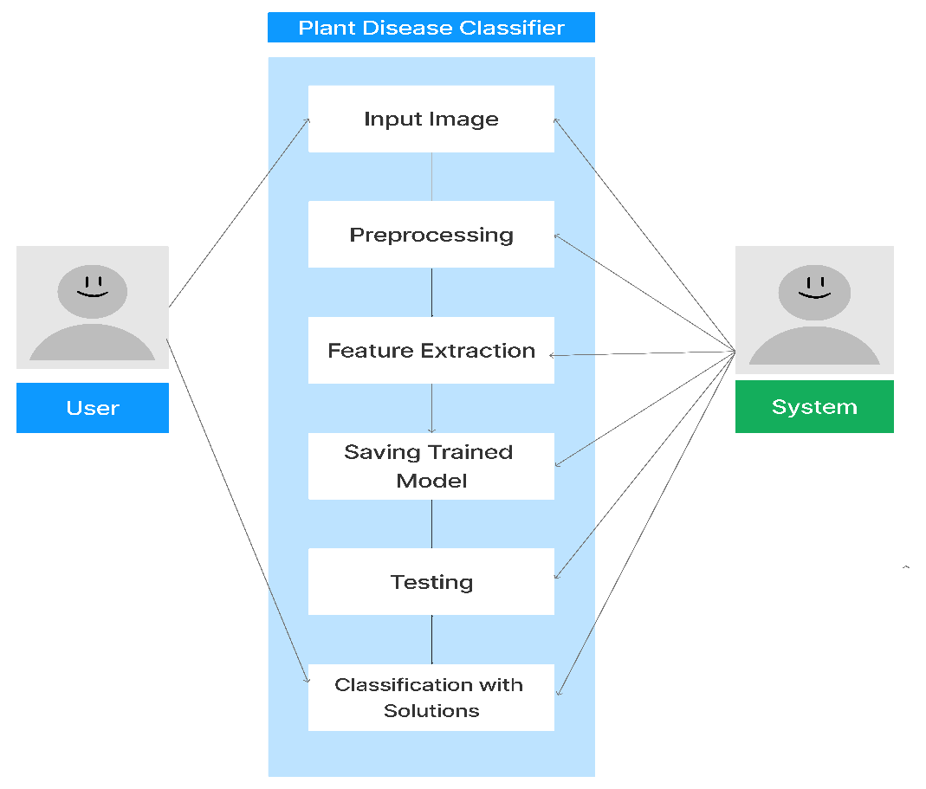
UML Diagrams – Use Case Diagram

Slide 13
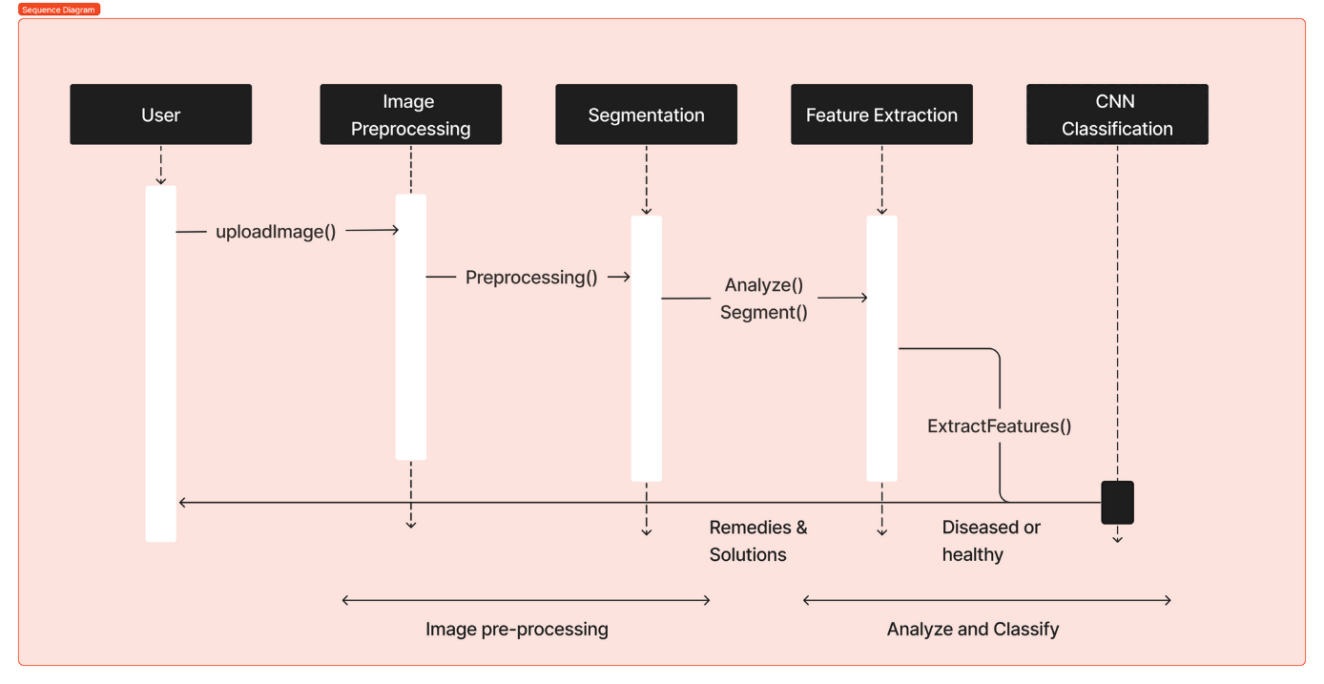
Sequence Diagram

Slide 14
Class Diagram

Slide 15
MODULES
1. Data set gathering
2. Image pre-processing
a. Reshaping & Resizing
b. Conversion of image to image array
c. Gray scale conversion
d. Image augmentation
3. Model building % Classification
4. Model training & Validation
5. Deployment

Slide 16
System Requirements
Software Requirements
Hardware Requirements
Base Software:
ENVI 5.6.3 and the ENVI Deep Learning 2.0 module
Operation System:
Windows 10 and 11 (Intel/AMD 64-bit)
Linux (Intel/AMD 64-bit, kernel 3.10.0 or higher, glibc 2.17 or higher
NVIDIA graphics card with CUDA Compute Capability version 3.5 to 8.6.8 GB of GPU Memory
NVIDIA GPU Driver version:
Windows 461.33 or higher, Linux 460.32.03 or higher
RAM: 4-8 GB RAM DDR
STORAGE: 100MB Free Space in HDD/SSD

Slide 17
Procedure

Slide 18
Procedure
01
02
03
04
Pre-processing
Data Augmentation
Building Convolutional Architecture
Model training
05
06
07
Over fit Test
Change Hyper parameter and Retrain Model
Test Model & Deploy

Slide 19
Pre Processing
Uses OpenCV
Data Augmentation.
04
Image data is manipulated here
03
Convert Image to Gray Scale.
02
Convert Image to Image Array
01
Resize Image

Slide 20
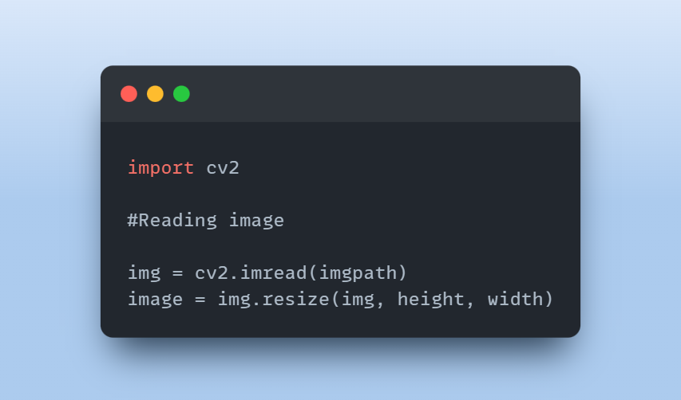
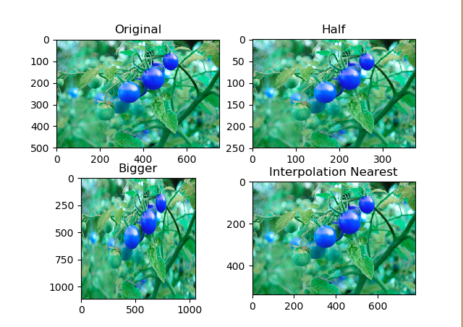
Image Resizing

Slide 21
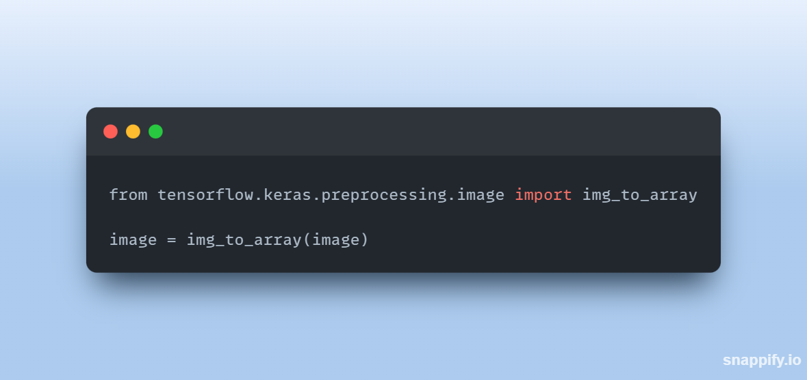
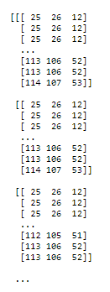
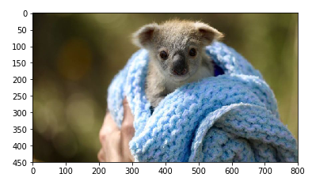
IMAGE TO ARRAY

Slide 22
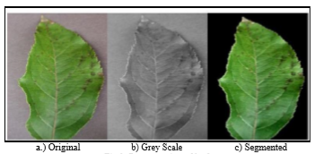
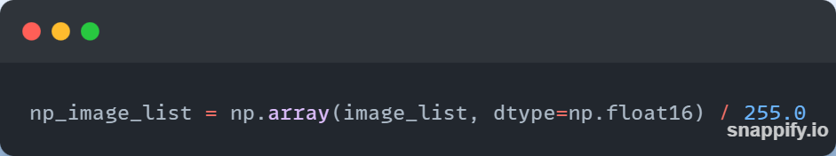
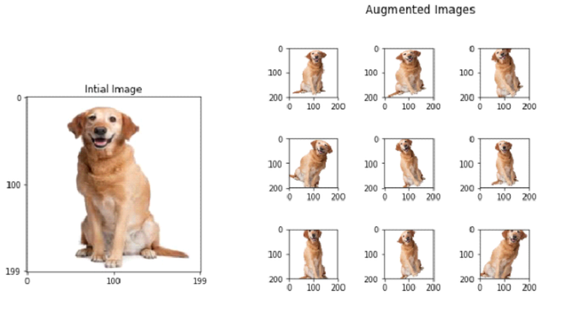
Image Gray Scaling and Augmentation

Slide 23
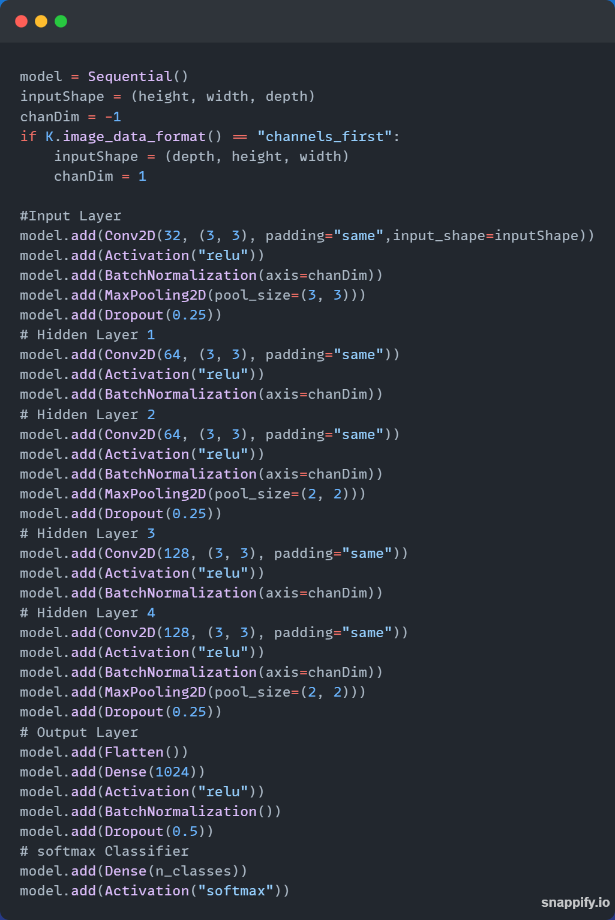
Model (Estimated)

Slide 24
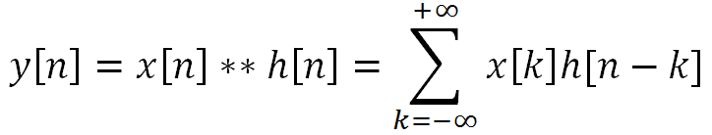
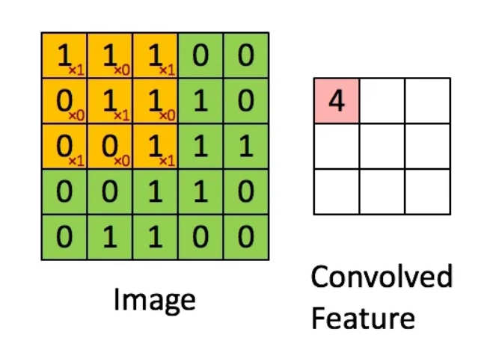
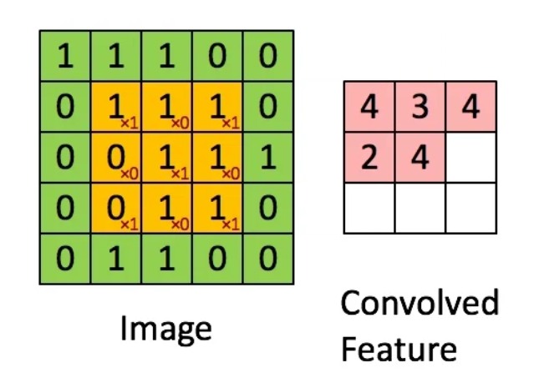
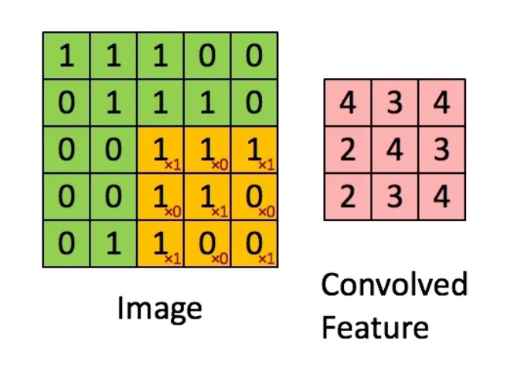
Understanding Convolution
Step 1
Step 2
Step 3

Slide 25
Hyper Parameters
01
02
Batch Normalization
Max Pooling
Model
03
04
Drop Out
Activation Function

Slide 26
Conclusion

Slide 27
Conclusion
Easy detection
Automated and less time consuming
Applications
Farmer decision impacts
Based on results farmers can make decisions
Risk assessment
If the crop has more chances of spotting
Remedies
Solutions and proper results

